Slide 1

Industry 4.0 in the Maritime Sector as a Driver for Sustainable Development: Legal Considerations on Smart Ports
Sustainable Development as Fundamental Pillar of Economic Governance and Public Affairs
9-10 November 2023
Prof. Dr. Elena Orrù
Department of Legal Studies
Alma Mater Studiorum – University of Bologna
Source of the picture: Adobe stock

Slide 2
Digitalization, Automation and Sustainability as Intertwined Drivers For Future Development
UNDP’s Digital Strategy for the years 2022-2025
Commission’s Communication “A Clean Planet for all. A European strategic long-term vision for a prosperous, modern, competitive and climate neutral economy” (COM/2018/773 final)
Commission’s Communication “The European Green Deal” (COM(2019) 640 final),
Commission’s communication of 9 March 2021 entitled “2030 Digital Compass: the European way for the Digital Decade” (the ‘Digital Compass Communication’
Decision (EU) 2022/2481 of the European Parliament and of the Council of 14 December 2022, establishing the Digital Decade policy programme 2030

Slide 3
What About the Transport Sector?
Commission’s “White Paper – Roadmap to a Single European Transport Area – Towards a competitive and resource efficient transport system” [COM (2011) 144 final]
Communication from the Commission to the European Parliament, the Council, the European Economic and Social Committee and the Committee of the Regions, adopted on 30 November 2016, “A European strategy on Cooperative Intelligent Transport Systems, a milestone towards cooperative, connected and automated mobility” (COM/2016/0766 final)
Communication from the Commission to the European Parliament, the Council, the European Economic and Social Committee and the Committee of the Regions “Sustainable and Smart Mobility Strategy – putting European transport on track for the future” (COM(2020) 789 final)
EU Green Deal Green Ports and Airports
IAPH’s 2019 World Ports Sustainability Programme (WPSP): integration of the SDGs into the business strategies and governance by port authorities.
Notes:
International Association of Ports and Harbors

Slide 4
Maritime and Port Sector
Safety and security purposes
Commercial purposes

Slide 5
IMO e-navigation strategy
For commercial purposes, several platforms have been created at the domestic level in order to enable the submission and interchange of information and data among the relevant authorities and the users through a single access point (one-stop-service).
Regulation (EU) 2020/1056 of the European Parliament and of the Council of 15 July 2020 on electronic freight transport information
Intelligent Transport Systems (ITSs): key tools as part of the Digital Single Market Strategy; since Horizon 2020 programme they imply both the integration of all the transport modes and their links with automation.
Integration of different systems, interoperability, multimodality
“The harmonized collection, integration, exchange, presentation and analysis of marine information on board and ashore by electronic means to enhance berth to berth navigation and related services for safety and security at sea and protection of the marine environment”
creation of eFTI (electronic freight transport information platforms)

Slide 6
What About Seaports?
Container terminal automation
Smart Port
Source of pictures: Terminal picture by Seshu B. on Unsplash; Istock via Unsplash
Notes:
Container terminal automation in order to manage the movement of containers therein

Slide 7
What Is A Smart Port?
Associated British Ports (ABP): Vessel Traffic Services and Port Management Information System, Just-In-Time solutions, machine learning and AI
Port of Antwerp Brugge
Digital Twin
Atlantic Smart Ports Blue Acceleration Network (AspBAN)
Ravenna Smart Port:
Port Community System (PCS)
Port of Livorno:
Virtual Reality (VR) applications + Digital Twin
Notes:
port community system (PCS)
piattaforma elettronica neutrale ed aperta che: consente lo scambio intelligente e sicuro di informazioni tra operatori pubblici e privati • ottimizzazione, gestione e automazione dei processi portuali e logistici. A COSA SERVE? • scambio telematico di dati e documenti • interoperabilità, trasparenza, decentramento

Slide 8
The Smart Port: A Conundrum?
No uniform empirical model
No uniform definition
Smart?
Smartphone: “a mobile phone that performs many of the functions of a computer”
Smart contract: “a computerized transaction protocol that executes the terms of a contract. The general objectives ... are to satisfy common contractual conditions (such as payment terms) ... and minimize the need for trusted intermediaries”
Smartcity: “a place where traditional networks and services are made more efficient with the use of digital solutions for the benefit of its inhabitants and business”
smart economy, smart citizens, smart governance, smart mobility, smart environment and lifestyle
Notes:
One of the first common uses of the term ‘smart’ in the aforesaid sense were smartphones. A smartphone can be described as ‘a mobile phone that performs many of the functions of a computer’ . This term was employed for the first time for describing Ericsson’s prototype GS88 ‘Panelope’ in 1997 , which worked on a computer operating environment GEOS and integrated different applications, such as SMS, emails, browser, integrated modem, infrared port and PC connection

Slide 9
Smart Ports Alliance (SPA):
“A smart port equips the workforce with the relevant skills and technology to facilitate the movement of goods, delivery of services and smooth flow of information”,
“A port that uses automation and innovative technologies including Artificial Intelligence (AI), Big Data, Internet of Things (IoT) and Blockchain to improve its performance”.
Belmoukari - Audy – Forget, “Smart port: a systematic literature review”:
“an effective, efficient, safe, and sustainable port [that] creates added value”,
an “intelligent port [that] is an alternative for effective decision support through the mobilization of new information and communication technologies (ICT) and decision support systems”.
Not merely a database or a single window where to share data,
but an application of the so-called Industry 4.0

Slide 10
AI
Digital twin
IoT
5G
Blockchain
Smart Port
Notes:
Machine-learning computational processes

Slide 11
Use of automation and innovative technologies for mobilizing new information and support decisions
effectiveness,
efficiency,
safety,
sustainability
creation of added value

Slide 12
Current Challenges
Public Law
Private Law
Public financed projects for the development of smart ports
No uniform model and regime for seaports, but
Potentially different Authorities and entities (within the port and outside it) whose functions can overlap or that need to be involved
Goal: integrated and interoperative system
Seaport as part of a multimodal-logistics system
Regime of the relationships among the different subjects
Who can be held liable in case of failure in the interpretation of the data and the prediction of the future situations?
On whom lies the responsibility for the final decision (the AI system and its manufacturer/provider or the Port Authority)?

Slide 13
Public Financing to Seaports
Art. 107 TFEU
State Aid Modernization (2012)
  State Aid Analytical Grids for transport infrastructures
Art. 107.3, let. b) and c), TFEU;
TEN-T;
GBER;
Green Ports;
Next Generation EU.
The construction, replacement or upgrade and maintenance of port infrastructure which is commercially exploited constitute an economic activity. Therefore, public funding of such infrastructure is in principle subject to State aid rules.

Slide 14
Port Community System (PCS)
Region / Local Government Bodies / Municipality
Port Authority
Terminals
Customs
Port Services Providers
Technical Nautical Services
Warehouses
Etc.
Maritime Authority
(if any)
Notes:
Port Community System as a Service
Tough co-operation

Slide 15
Final Considerations
When incorporated into an efficient and smart multimodal network, smart ports are key drivers for the future sustainable development from different points of view.
Need to enact technologically neutral Public Law and Private Law rules.
Uncertainty both at the domestic and at the EU / international level about the applicable regime/s of liability.

Slide 16
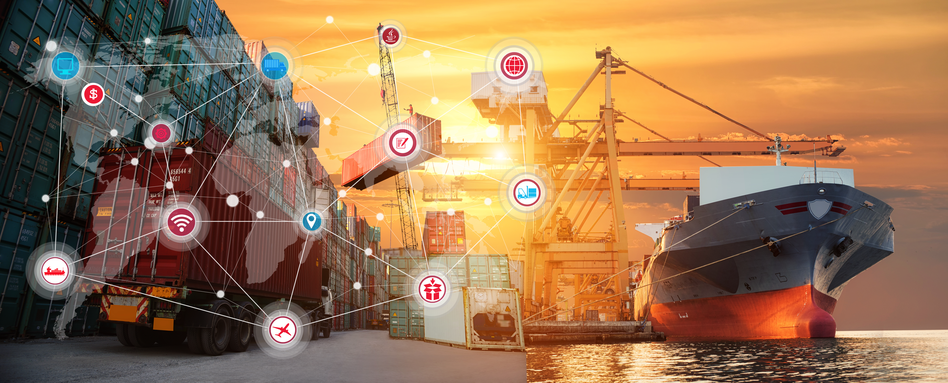
Thank you for your kind attention!
Any questions?
Source of the picture: Shutterstock

Slide 17
Prof. Dr. Elena Orrù
Associate Professor of Navigation and Transportation Law
Department of Legal Studies – DSG
Alma Mater Studiorum – University of Bologna
elena.orru2@unibo.it
https://www.unibo.it/sitoweb/elena.orru2/

